Slide 1

ADIUNCHCHANAGIRI INSTITUTE OF TECHNOLOGY
DEPARTMENT OF INFORMATION SCIENCE AND TECHNOLOGY
SOCIAL CONNECTIVITY AND RESPONSIBILITY
FROM :
Moulya M Prasad(4AI21IS035)
Tanu C R(4AI21IS058)
Thrisha N A(4AI21IS059)
Sanjana H J(4AI21IS041)
Shreya N S(4AI21IS047)
TO :
Mrs.Deepashri K S
Assistant professor
Dept of ISE

Slide 2
MODULE 1 PLANTATION AND ADOPTATION OF A TREE
WHAT IS PLANTATION AND ADOPTATION ?
A tree plantation, forest plantation, plantation forest, timber plantation or tree farm is a forest planted for high volume production of wood, usually by planting one type of tree as a monoculture forest.
WWF India initiated the 'Adopt a Tree' campaign in 2005 to encourage individuals and organisations to plant and care for native species.
Since then, we and our partners have grown and managed thousands of trees. Each one of us can adopt a tree for life and help make our planet a greener place.
Tree plantation is very necessary because trees provide oxygen to the environment and make the air quality better.
If more trees are planted, then the world's environment will become a safer place to live in.
Tree plantation also reduces pollution, thus making the life of future generations secure.

Slide 3
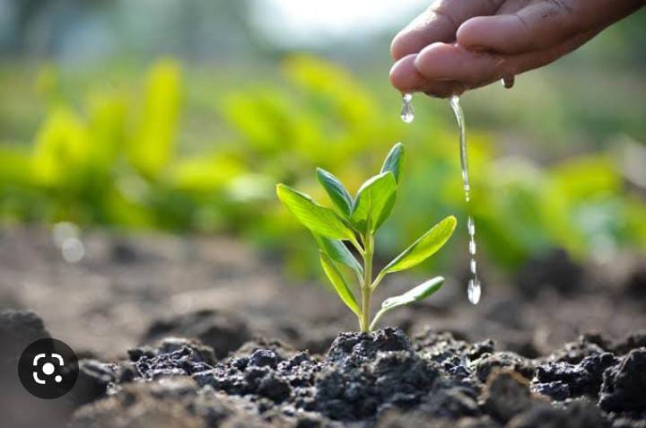
BENEFITS OF PLANTATION:
Biomass for cooking fuel
Decarbonising the atmosphere
Sound absorption and windbreak
Cooling Urban areas
Removing Pollutants
Oxygen generation
Recharging ground water
Preventing Soil and reducing flood
Medical Value
Air/Water improvement
Fig 1.1 : Plant

Slide 4
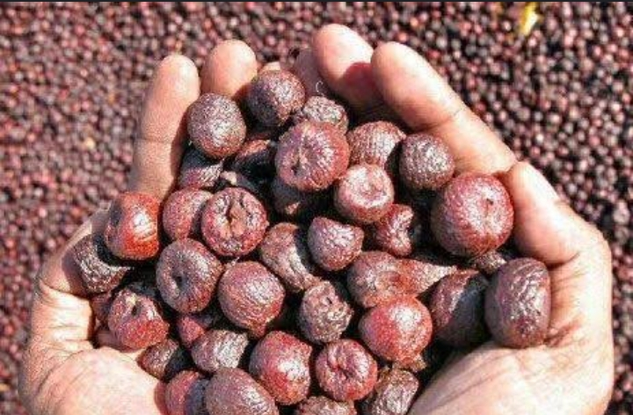
ARECANUT:
ABOUT:
Areca catechu is a species of palm which grows in much of the tropical Pacific, Asia, and parts of east Africa.
Scientific name: Areca catechu
Rank: Species
Family: Arecaceae
Higher classification: Areca palm
Kingdom: Plantae
Order: Arecales
INTRODUCTION TO ARECANUT CULTIVATION:
The areca nut palm produces the common chewing nut which is popularly known as betal nut or supari .
In India, areca nut is very much linked with religious practices .
India is the largest producer and consumer of areca nut in the world.
The areca nut is not a true nut ,but rather a fruit categorized as a drupe.
Commercial Cultivation of areca nut is more successful in India .
Fig 1.2: Arecanut

Slide 5
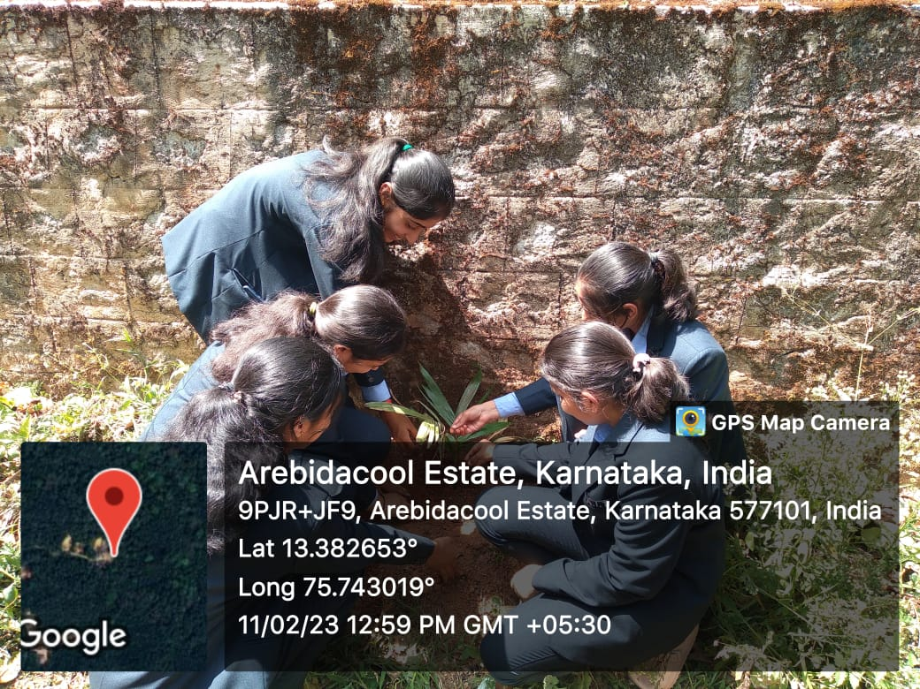
Fig 1.3: Plantation

Slide 6
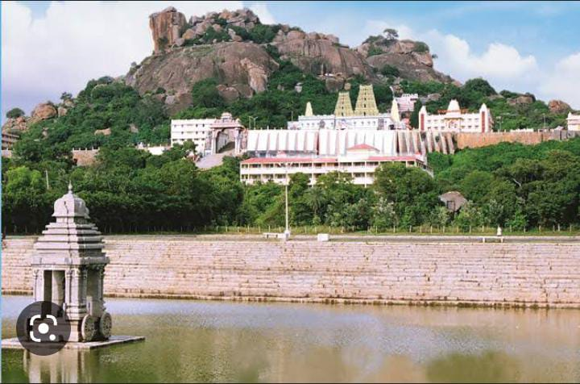
MODULE 2 HERITAGE WALK AND CRAFTS CORNERS
WHAT IS HERITAGE TOURISM?
Cultural heritage tourism (or just heritage tourism) is a branch of tourism oriented towards the cultural heritage of the location where tourism is occurring.
The National Trust of Historic Preservation in the United States defines heritage tourism as "traveling to experience the places, artifacts and activities that authentically represent the stories and people of the past", and "heritage tourism can include cultural, historic and natural resources.
Fig 2.1: Adichunchanagiri math

Slide 7
Adichunchanagiri, also called Mahasamsthana Math, is a hill township in Nagamangala Taluk,Mandya District,Karnataka State, India
It is the spiritual headquarters of the Natha Parampare and Jogi Cult of Hindus of Karnataka.
Kalabhairaveshwara Temple -
Sri Kalabhairaveshwara is the Kshetra Palaka of Sri Adichunchanagiri Mahasamsthana Math. Lord Gangadhareshwara is the presiding deity.
The Pancha Lingas, the Jwala Peetha, Sthambamba are all held in great reverence by the devotees.
The peak point of the Giri (hillock) is known as Akasha Bhairava and the sacred pond by the temple is Bindu Sarovara.
Two lakes have been built for the deepostava programmes. The old Bindu Sarovara was also renovated as per agama tradition.

Slide 8
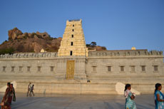
It is one of the ancient temples whose history runs for about 2000 years. Ancient Vedic culture was founded here.
All the yagnas and prayers along with natural resonance are the reason for spirituality present here.
According to some transcriptions Adirudra gave this temple to Siddha yogi.
After the long transfer of power now the present head is Sri Sri Sri Nirmalanandanantha Swamiji. He is the 72nd head of this mutt.
According to mythology, it is believed that Lord Shiva killed two demons chuncha and kancha here.
After that, he gave the place to Siddha yogi who established a Natha tradition. Shiva also guided him to disseminate the righteousness in the society
Fig 2.2 : Temple

Slide 9
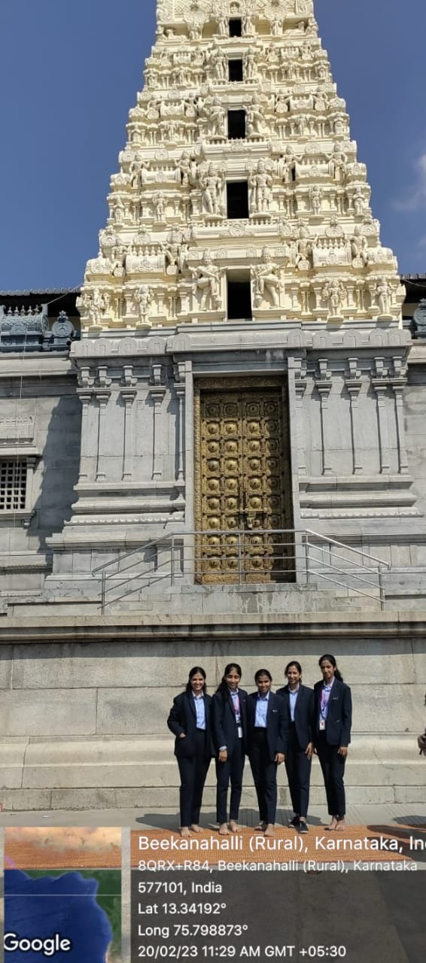
Fig 2.3: Heritage walk

Slide 10
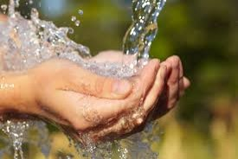
MODULE 3 WATER CONSERVATION
WHAT IS WATER CONSERVATION?
Water conservation is the practice of using water efficiently to reduce unnecessary water usage. According to Fresh Water Watch, water conservation is important because fresh clean water is a limited resource, as well as a costly one.
The Aims of water conservation efforts include
With less than 1% of the worlds water being freshwater , one aim is ensuring the availability of water for future generation where the withdrawal of freshwater from a ecosystem does not exceed its natural replacement rate.
Energy conservation as water pumping, delivery, and wastewater treatment facilities consume a significant amount of energy.
Fig 3.1:water

Slide 11
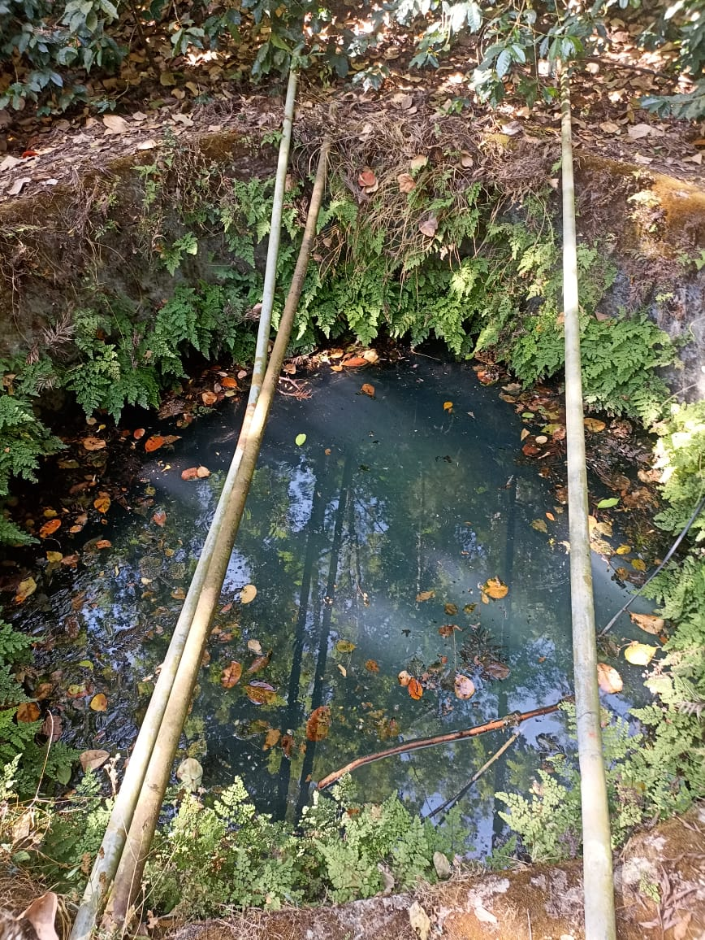
WHAT ARE THE WAYS OF CONSERVING WATER :
Rain water Harvesting
Re-Using water
Using water sparingly
Storing Water in dam
Agricultural Well –
Water is an essential requirement when growing plants and rearing livestock. Many people struggle with municipal water supply since it can be unreliable, costly, and filled with chemicals that can ultimately harm your livestock and the environment.
You can dig a well locally using well-drilling services, which will provide you with a regular water supply.
Moreover, you will know the water quality and can trust it to be free from harmful chemicals.
Fig 3.2:Agricultural well

Slide 12
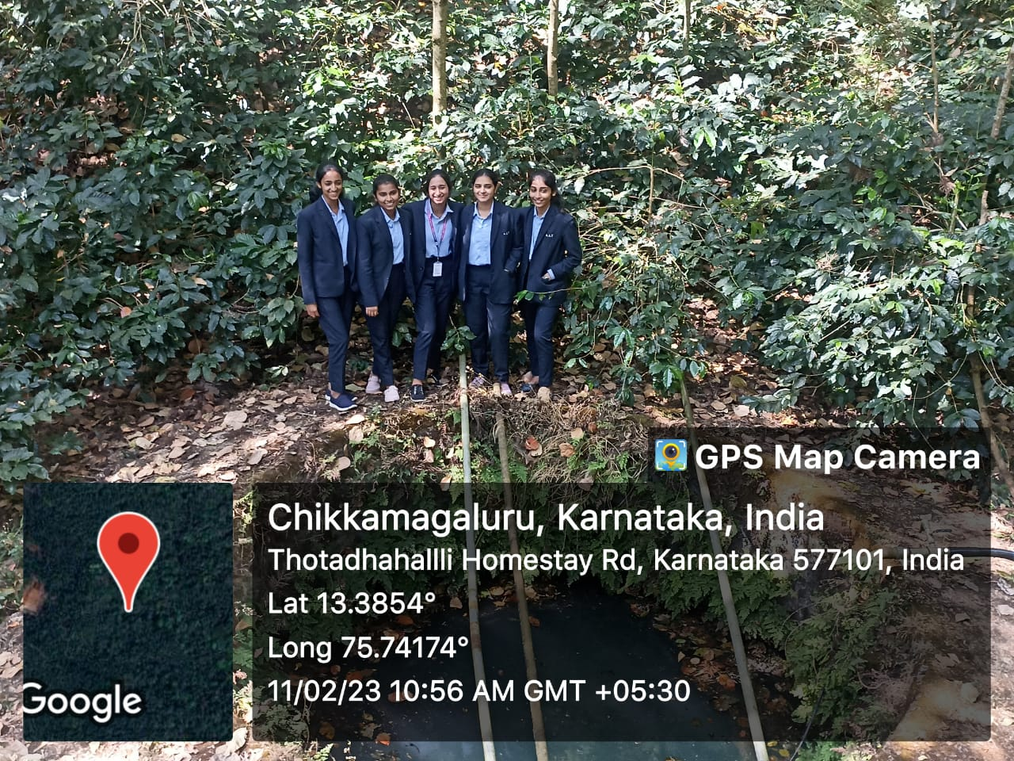
Fig 3.3:Agricultural Well

Slide 13
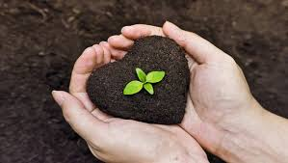
MODULE 4 ORGANIC FARMING AND WASTE MANAGEMENT
ORGANIC FARMING MANAGEMENT :
Organic farming envisages a comprehensive management approach to improve soil health, the ecosystem of the region and the quality of produce living soil can be maintained by continuous incorporation of crop and weed biomass.
As a thumb rule, crop residues and cattle excreta should be returned to the plot, directly or indirectly.
As a strategy, the quantity of biomass removed for human food and fiber, cattle feed or firewood from an organic farm should be replaced with any other bio-waste on the farm.
Fig 4.1:Soil

Slide 14
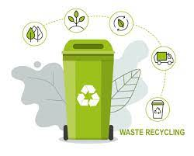
WASTE MANAGEMENT:
Waste management or waste disposal includes the processes and actions required to manage waste from its inception to its final disposal .
This includes the collection, transport, treatment and disposal of waste, together with monitoring and regulation of the waste management process and waste-related laws, technologies, economic mechanisms.
Waste can be solid, liquid, or gases and each type has different methods of disposal and management.
Health issues are associated throughout the entire process of waste management.
The aim of waste management is to reduce the dangerous effects of such waste on the environment and human health.
Fig 4.2:Waste recycling

Slide 15
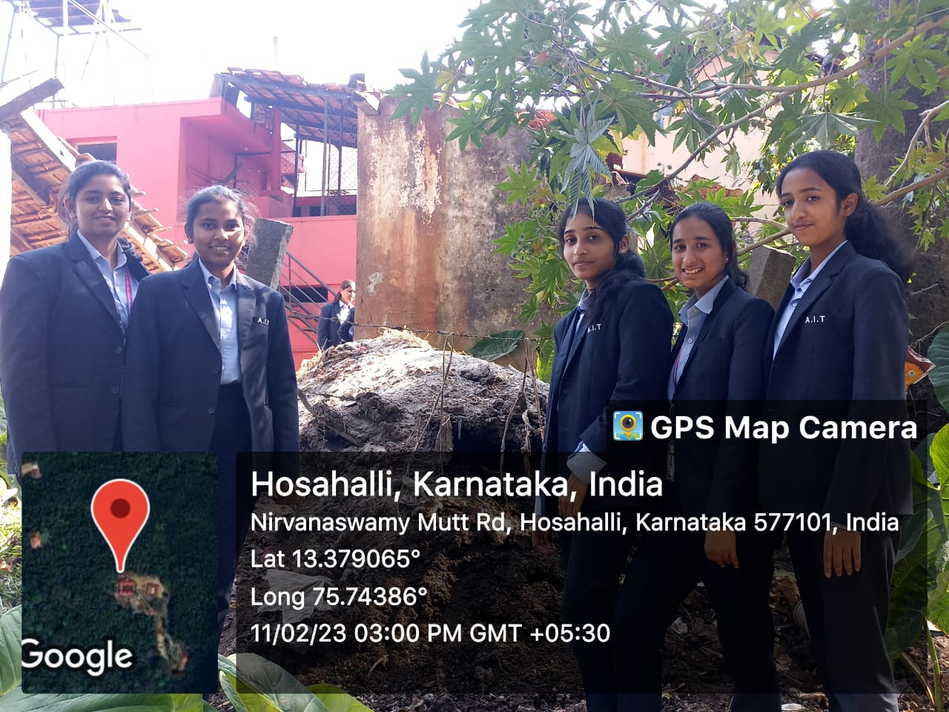
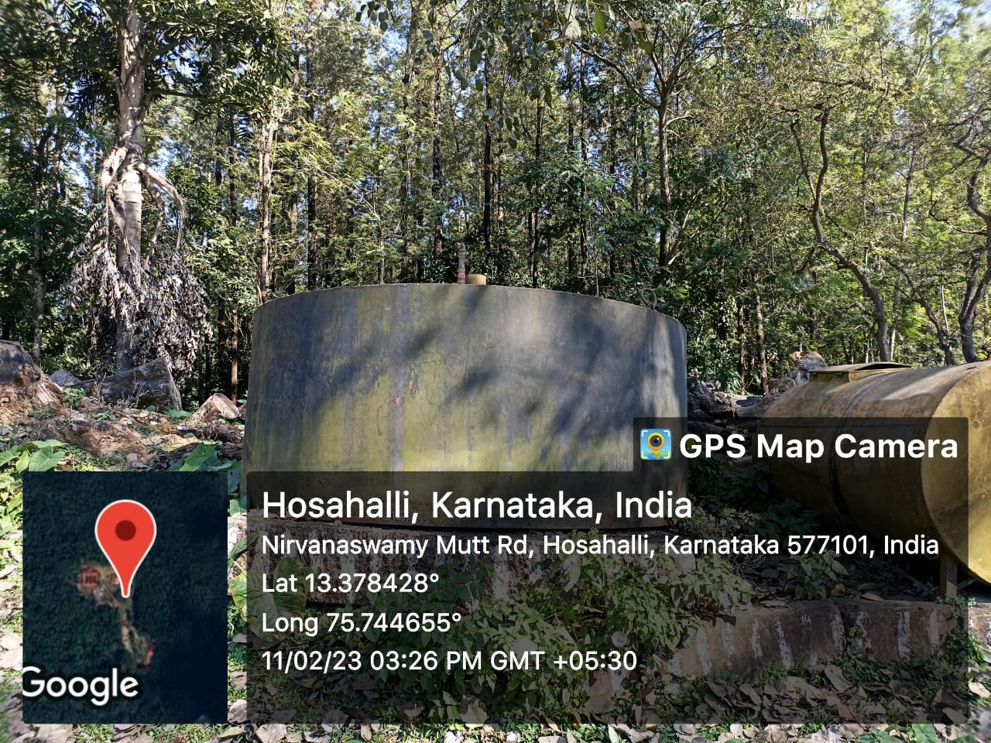
Fig 4.3:Waste management

Slide 16
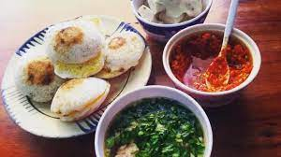
MODULE 5 FOOD WALK
WHAT IS FOOD WALK?
During a food walk, you usually go out with a group of people, led by a local expert who is a food lover too. You walk down a locality and try to get under its skin through its food. You don't always have to 'walk' though. There could be variations.
BENEFITS OF FOOD WALK:
Immersion into local or street food culture
History and Traditions Behind the Food We Eat
Supporting local economies by patronizing small businesses and food markets
Opportunities to try unique and authentic dishes
Fig 5.1:food

Slide 17
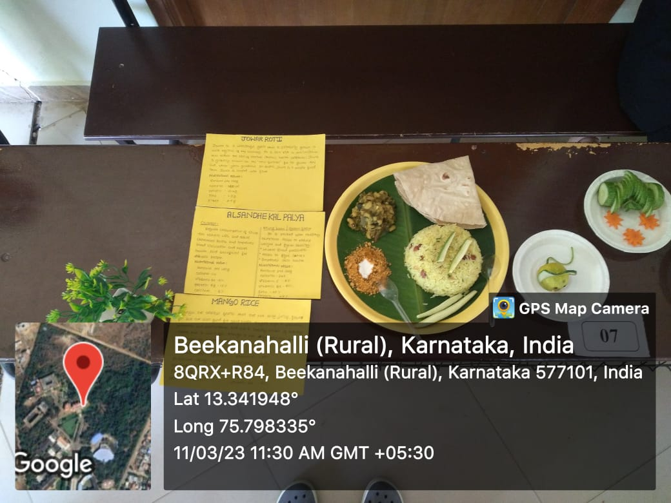
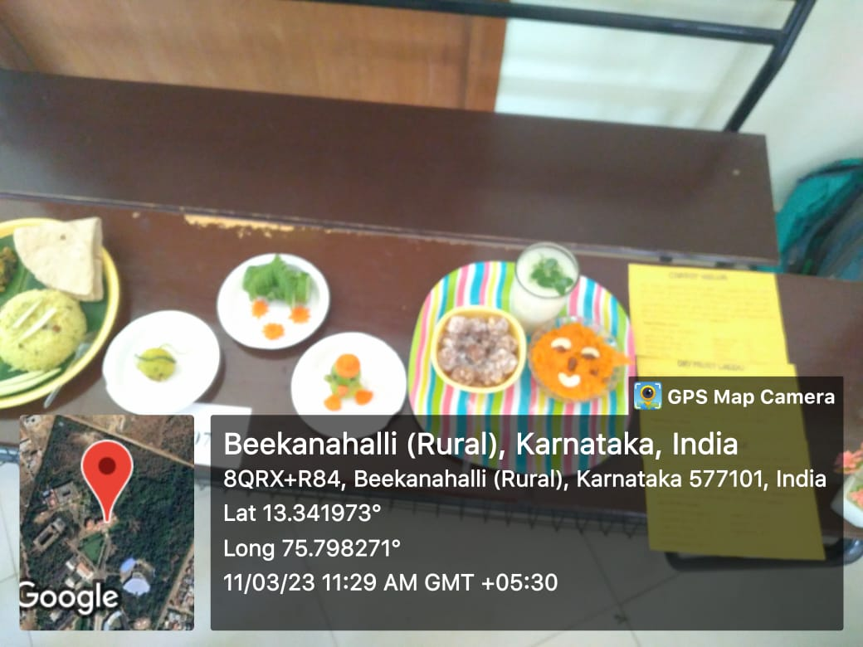
Fig 5.2: Food Walk
IMPORTANCE OF NUTRITIONS:
The essential nutrients are vitamins, minerals, protein, fats, water, and carbohydrates. People need to consume these nutrients from dietary sources for proper body function.
Essential nutrients are crucial in supporting a person's reproduction, good health, and growth.

Slide 18
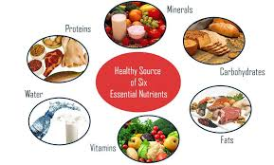
ESSENTIAL NUTRIENTS:
Proteins
Vitamins
Minerals
Fats
Carbohydrates
Water
Fig 5.3 :Essential nutrients

Slide 19
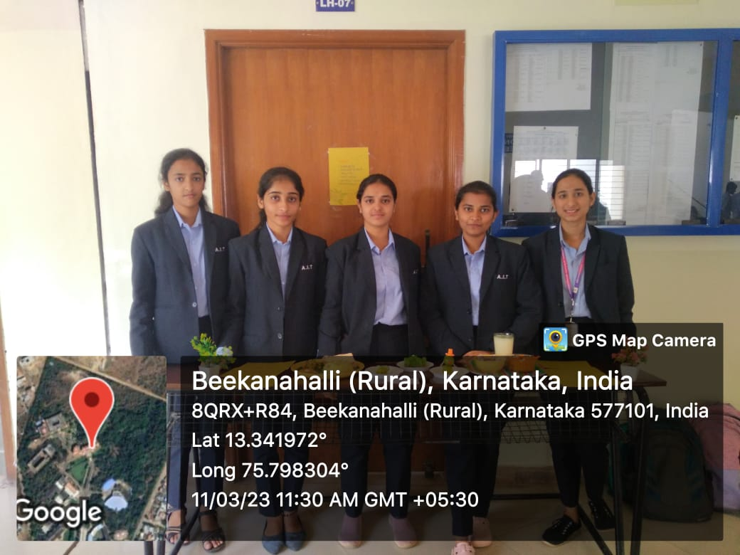
Fig 5.4: Food Walk

Slide 20
THANK YOU

